Slide 1
Connecting Claude and VS Code
SISMID Lab: Supplementary Materials
July 22 through July 24, 2026
A Human – AI Teaming Approach to Infectious Disease Modeling

Slide 2
Roadmap
This slide deck provides a step-by-step walkthrough of connecting Claude and VS Code.
If you do not have a Claude account, you will not be able to connect Claude and VS Code. Please refer to the appropriate slide-deck to connect the AI of your choice to VS Code.
If you run into issues, please first work with the AI of your choice to troubleshoot.
If you continue to have issues, please reach out to Amanda Bleichrodt (ambleic@clemson.edu).

Slide 3
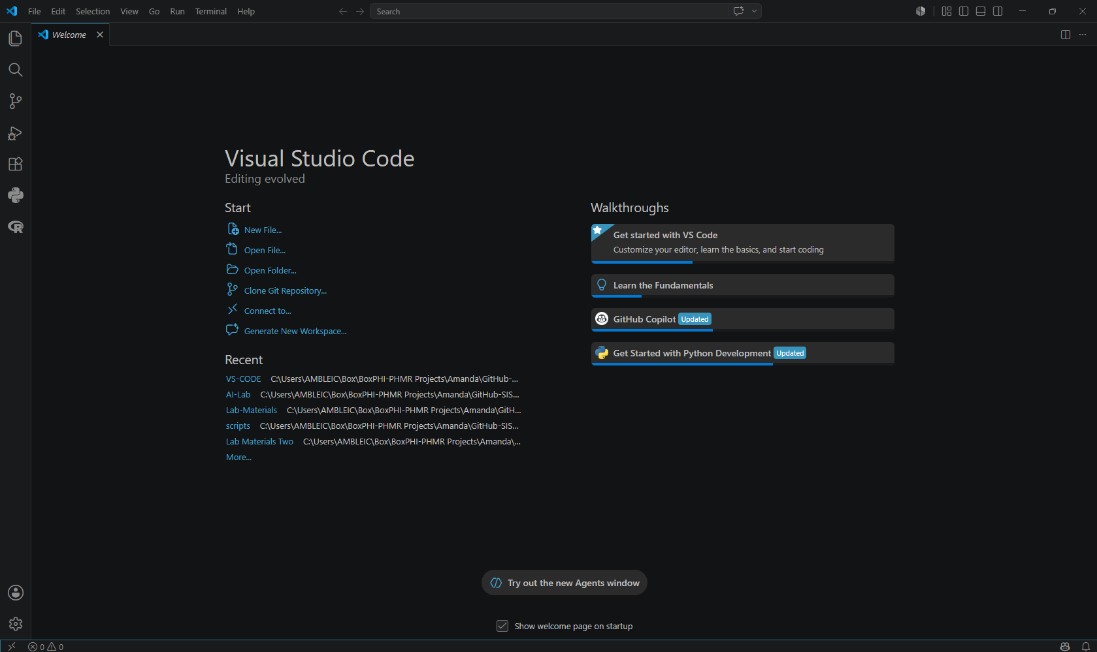
Step 1: Opening the Extensions Menu
To connect Claude to VS Code, first press:
MAC: Cmd+Shift+X
Windows/Linux: Ctrl+Shift+X
This opens the Extensions view where we can download the “Claude Code” extension. If that does not work, click the Extensions icon on the left side of the page.

Slide 4
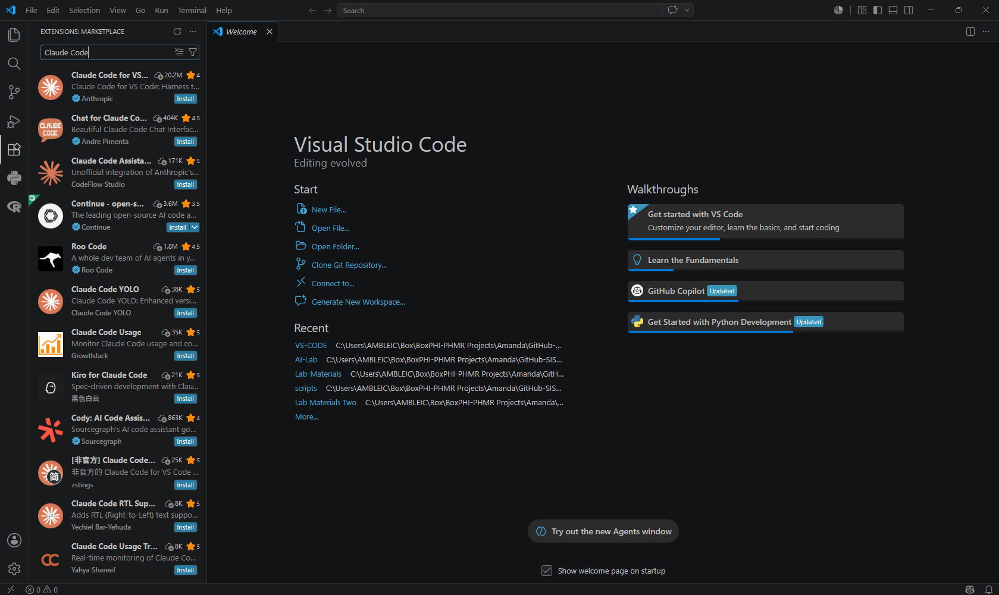
Step 2: Installing Claude Code
Once you have opened the Extensions Marketplace, then search for “Claude Code”. The first option you should see is “Claude Code for VS”; click Install.

Slide 5
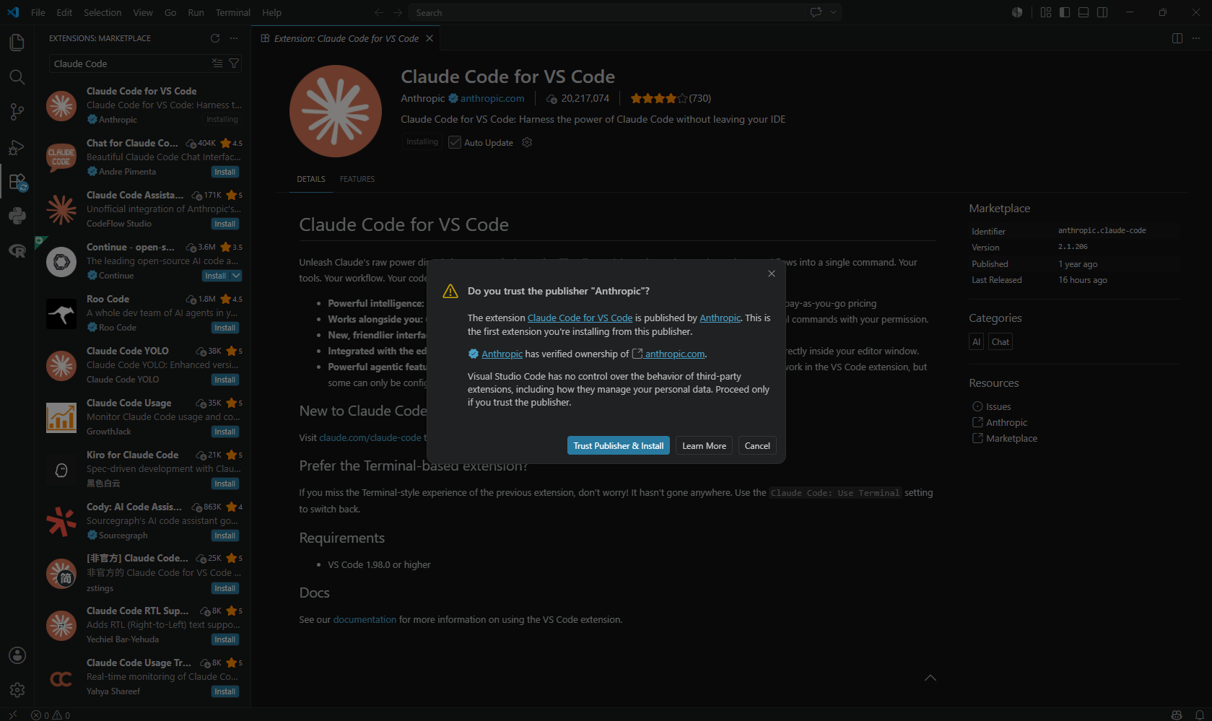
Step 3: Trust Message
You may see a message pop up asking, “Do you trust the publisher ‘Anthropic’?”. If you do, click Trust Publisher & Install.

Slide 6
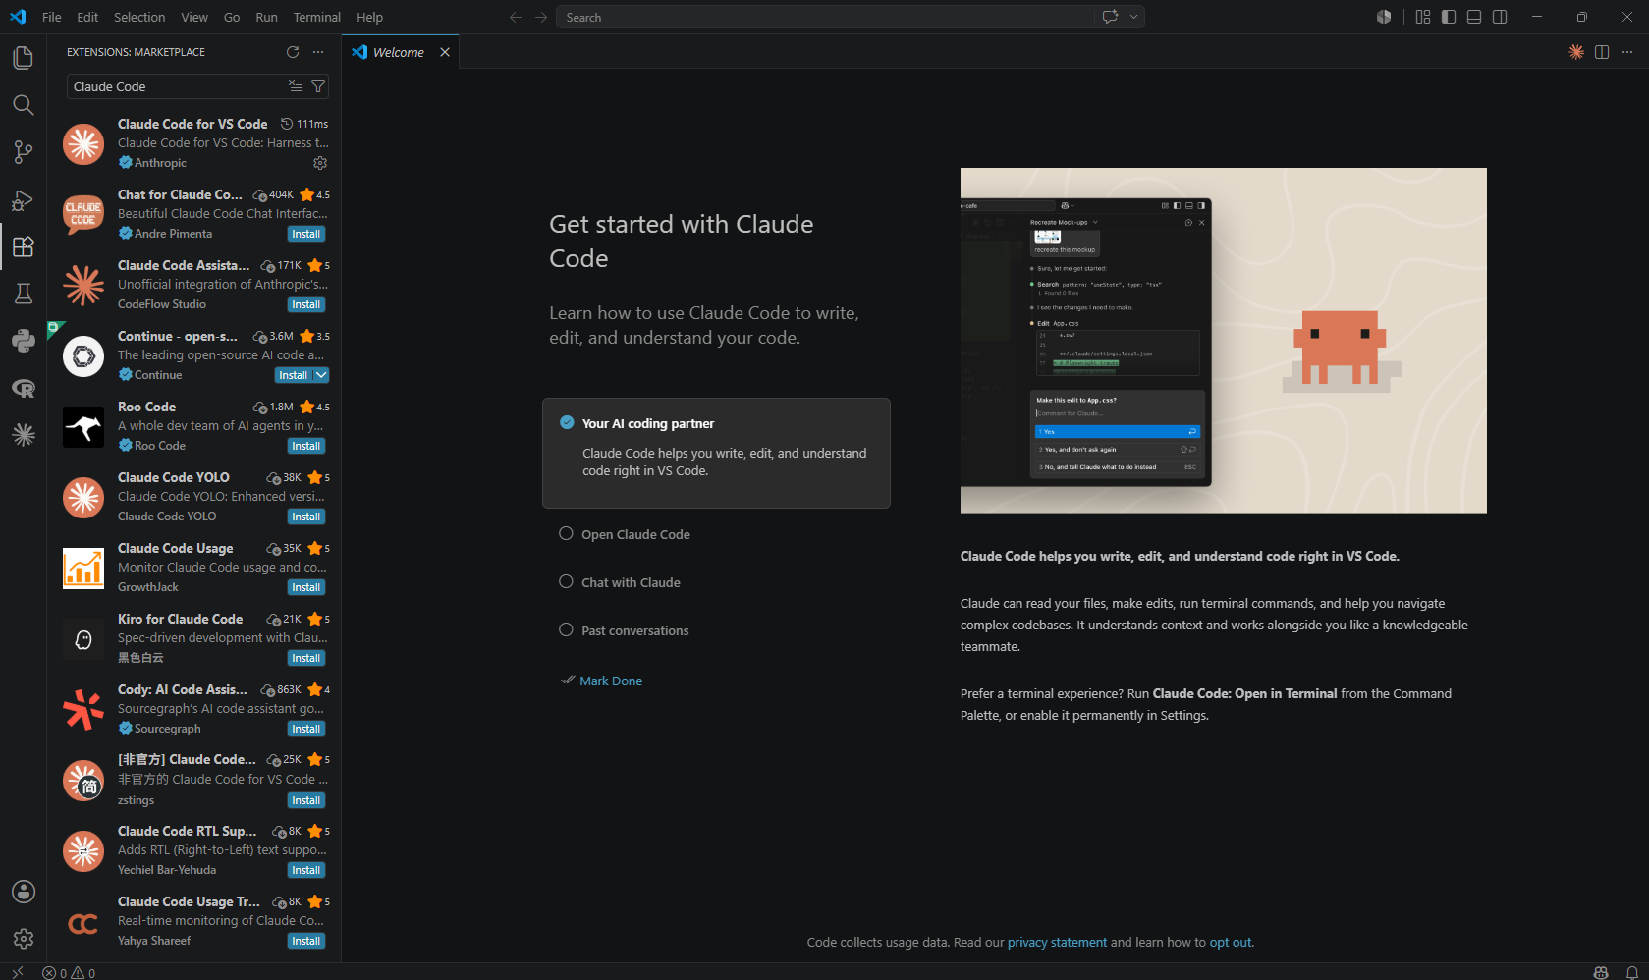
Step 4: Opening the Claude Chat
Once “Claude Code” has been installed, we can now open the chat box and start the process to connect our Claude account to VS Code. To open the Claude chat, click the orange spark in the upper right-hand corner of the page.

Slide 7
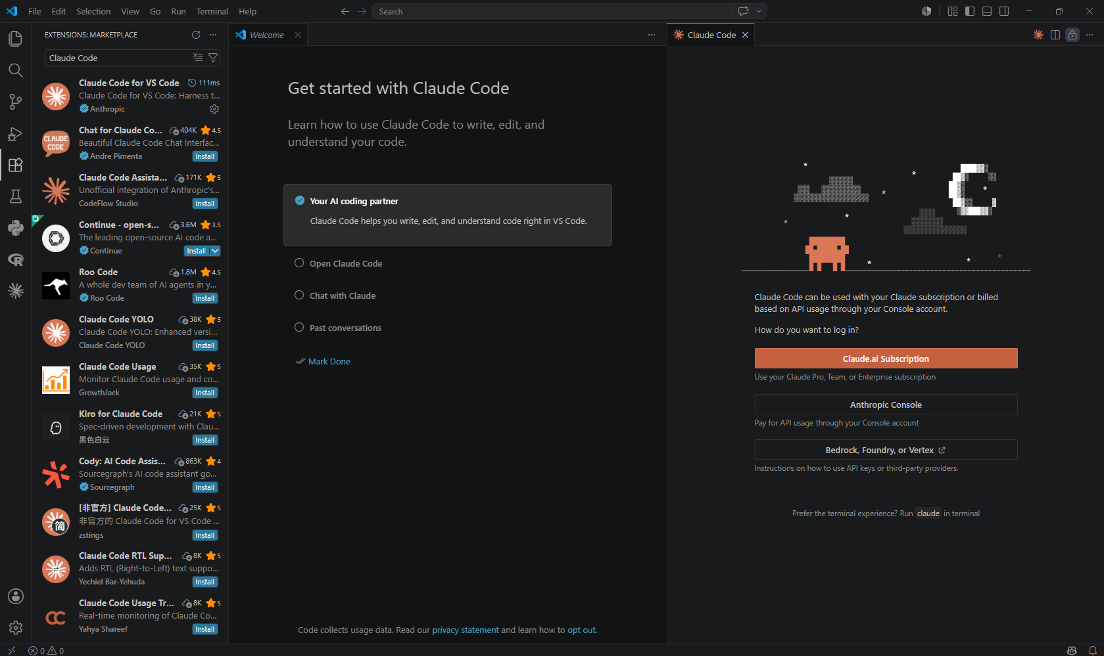
Step 5: Connecting to Claude.ai Subscription
When you first download Claude Code and open the chat box, you will be prompted to connect to your Claude subscription. To start that process, click Claude.ai Subscription.

Slide 8
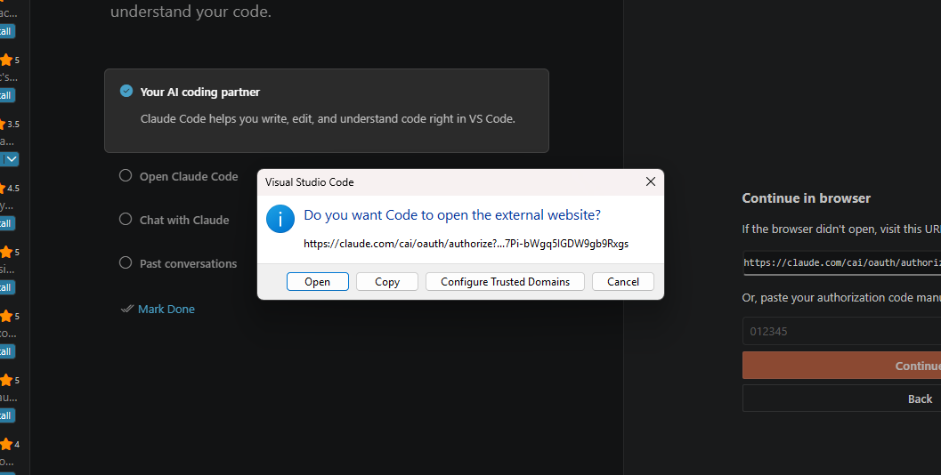
Step 6: Opening Claude.ai Log-In Page
After clicking on the Claude.ai Subscription button (Step 5), VS Code will ask if you want to open the external website. Click Open.

Slide 9
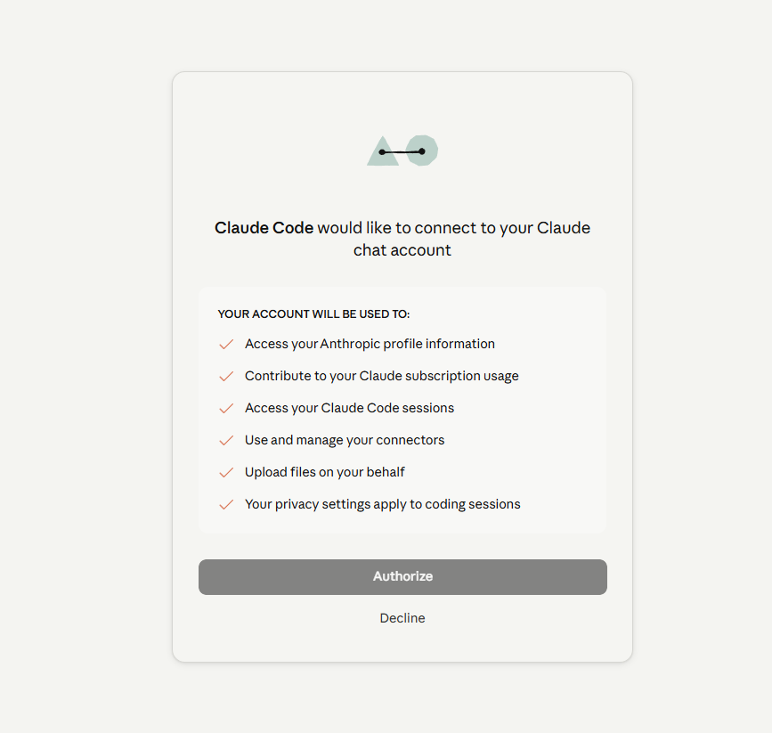
Step 7: Authorizing Claude Code
Once the webpage opens, you will need to authorize Claude Code to connect to your Claude chat account. Essentially, you are authorizing Claude to do all things under the YOUR ACCOUNT WILL BE USED TO: header. To authorize and continue the process of connecting Claude and VS Code, click Authorize.

Slide 10
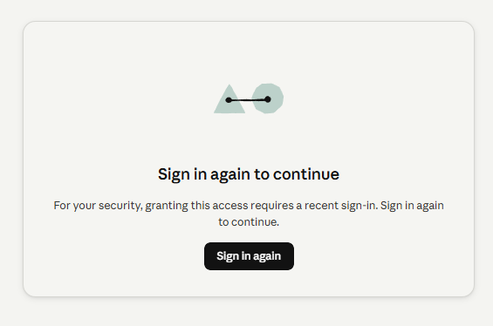
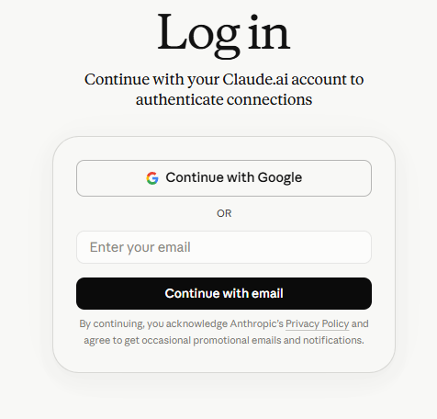
Step 8: Signing into Claude
After clicking Authorize, you may be prompted to sign into Claude. To do so, click Sign in again. You will then be prompted to log into your Claude account.

Slide 11
Step 9: Authorizing Claude Code
After logging in, you will be prompted to authorize Claude Code to connect to your Claude chat account again. Essentially, you are authorizing Claude to do all things under the YOUR ACCOUNT WILL BE USED TO: header. To authorize and finish the process of connecting Claude and VS Code, click Authorize.

Slide 12
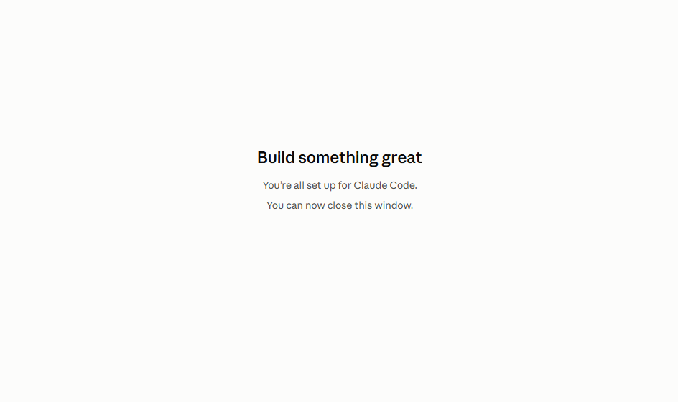
Step 10: Confirming Set Up
After logging in (Step 8) and authorizing Claude Code (Step 9) you should see Build something great. Once you make it to this screen, you can close the window and navigate back to VS Code.
If you do not see this screen, please let us know!

Slide 13
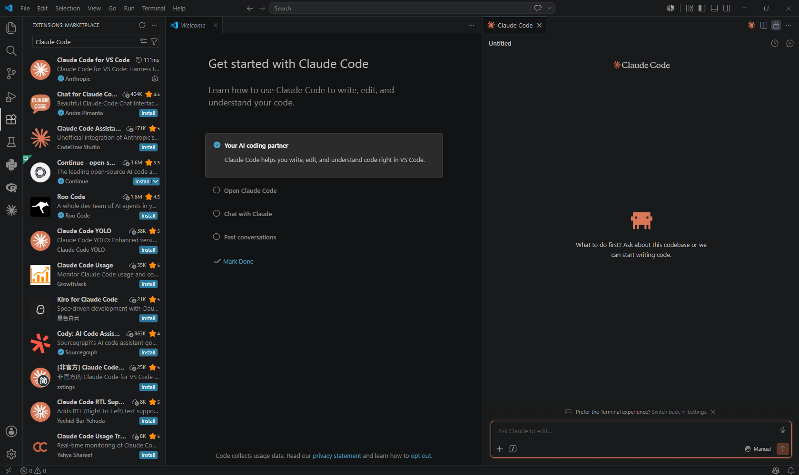
Claude in VS Code
Once you navigate back to VS Code, you should now see the chat box for Claude Code ready to go. If you close out the chat, you can re-open it by clicking the orange spark icon (Step 4).

Slide 14
Want to learn more?
https://code.claude.com/docs/en/vs-code

